Slide 1



A MIDDLEWARE FOR INTER-VENDOR MOBILE ROBOT COMMUNICATION
INITIAL MASTER THESIS PRESENTATION
Introduction | Problem Statement | Task Description | Research Questions | Related Work | Significance | References
Mai Khanh Isabelle Wilhelm | Fachgebiet Service-centric Networking | TU Berlin & Telekom Innovation Laboratories
Notes:
Remarks
- Mandatory: Presentation title, presentation structure, name & affiliation
- Title photo can be replaced by another that fits to the presentation (if no appropriate photo is available, go with this one)

Slide 2
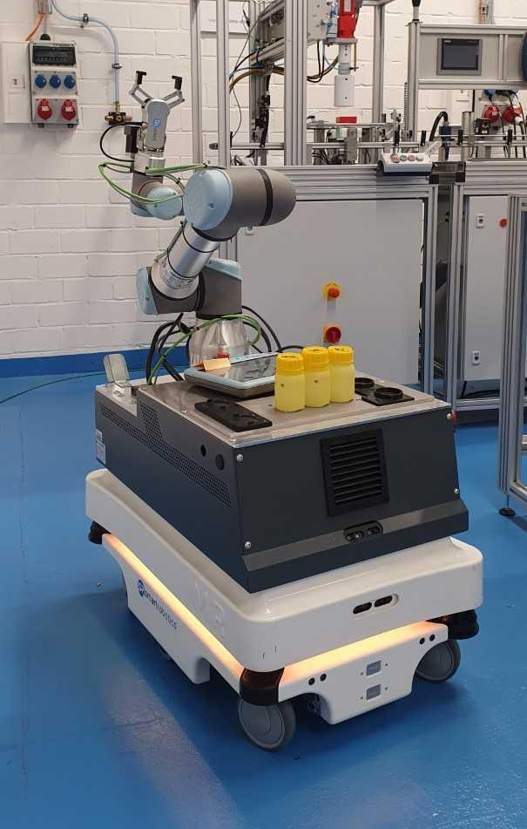
1. INTRODUCTION
BACKGROUND
Industry 4.0
Brought to public in 2011 [1]
Digitize the industry [1]
Goals: [2]
Automating processes
Increase effectiveness & efficiency
Lower material & human resources
Increase flexibility
Challenges: [2]
Real-time data exchange
Flexibility
Security
Connecting devices & exchange information [2]
Mobile Robots
Machines that use sensors and software to move [3]
To adapt to changing requirements [4, 5]
Vendor-dependent applications & interfaces [6]
Multi-vendor strategies require communication standard [2]
Fig. 1 Mobile robot MIR 100
Notes:
Slide with one picture
Remarks:
picture is to be placed preferably on the left hand side
picture should be framed and have a small shadow (use features of the presentation tool, but make sure to use the same properties on all slides)
text goes on the right hand side
normal text in bullet points: Helvetica 30 pts (or larger, but use the same font size on all slides)
titles for bullet points: Helvetica 40 pts (or larger, approx 10pts larger than normal text, but use the same font size on all slides) - titles for bullet points are optional
Slide title: Helvetica, 45 pt, bold, uppercase (mandatory)
Slide sub-title: Helvetica, 45 pt, uppercase (optional)
Reference lines are like red lines - they must not be crossed (only in some exceptional cases like for pictures with oversize)
Slide is to be built from bottom to top - start with aligning content and pictures at the bottom reference line

Slide 3
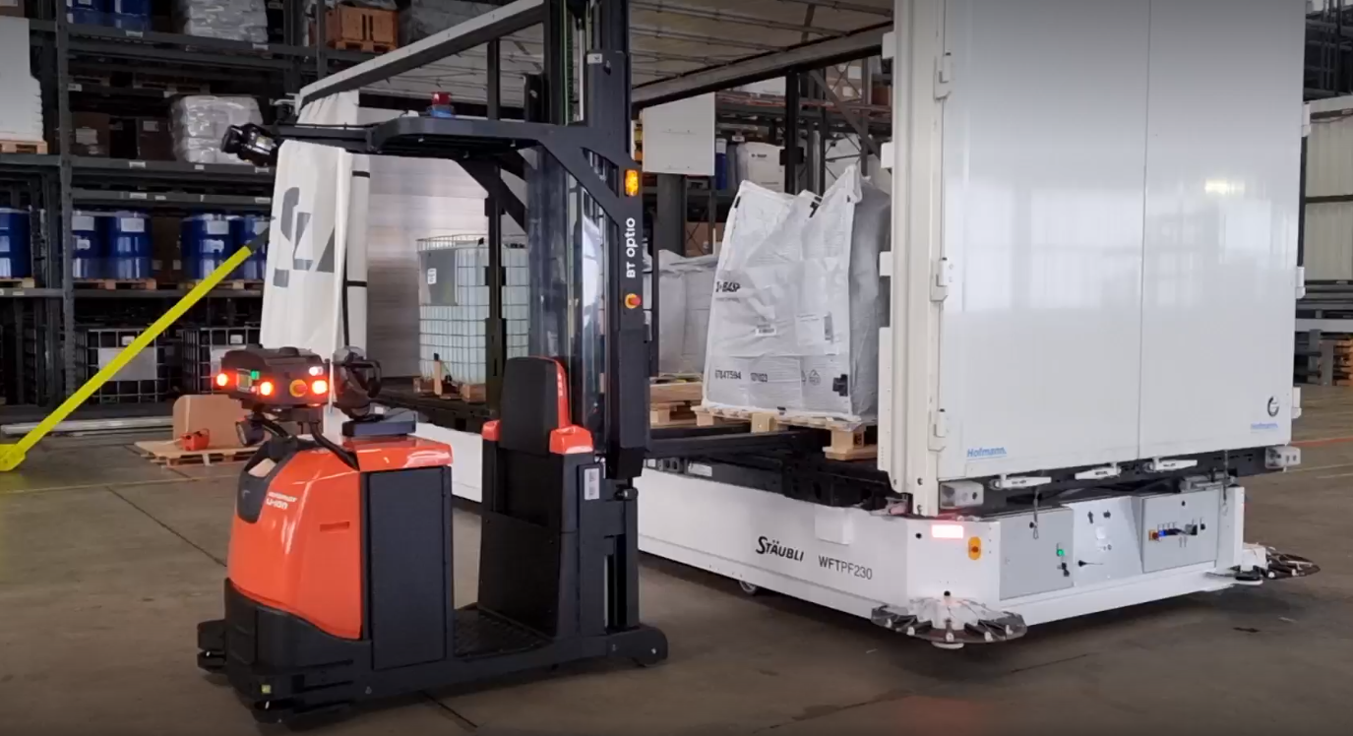
1. INTRODUCTION
PILOT PROJECT
Use of a Driverless Transport
Tested at BASF site in Kaisten [7]
Started in 2021 [7, 8]
A driverless, fully autonomous vehicle [7, 8]
Transport products between production & logistics warehouse [7, 9]
Manually loaded [8]
Automatically unloaded by a mobile robot from a different vendor [10]
Fig. 2 Pilot project at BASF in Kaisten [11]
Notes:
Slide with one picture
Remarks:
picture is to be placed preferably on the left hand side
picture should be framed and have a small shadow (use features of the presentation tool, but make sure to use the same properties on all slides)
text goes on the right hand side
normal text in bullet points: Helvetica 30 pts (or larger, but use the same font size on all slides)
titles for bullet points: Helvetica 40 pts (or larger, approx 10pts larger than normal text, but use the same font size on all slides) - titles for bullet points are optional
Slide title: Helvetica, 45 pt, bold, uppercase (mandatory)
Slide sub-title: Helvetica, 45 pt, uppercase (optional)
Reference lines are like red lines - they must not be crossed (only in some exceptional cases like for pictures with oversize)
Slide is to be built from bottom to top - start with aligning content and pictures at the bottom reference line

Slide 4
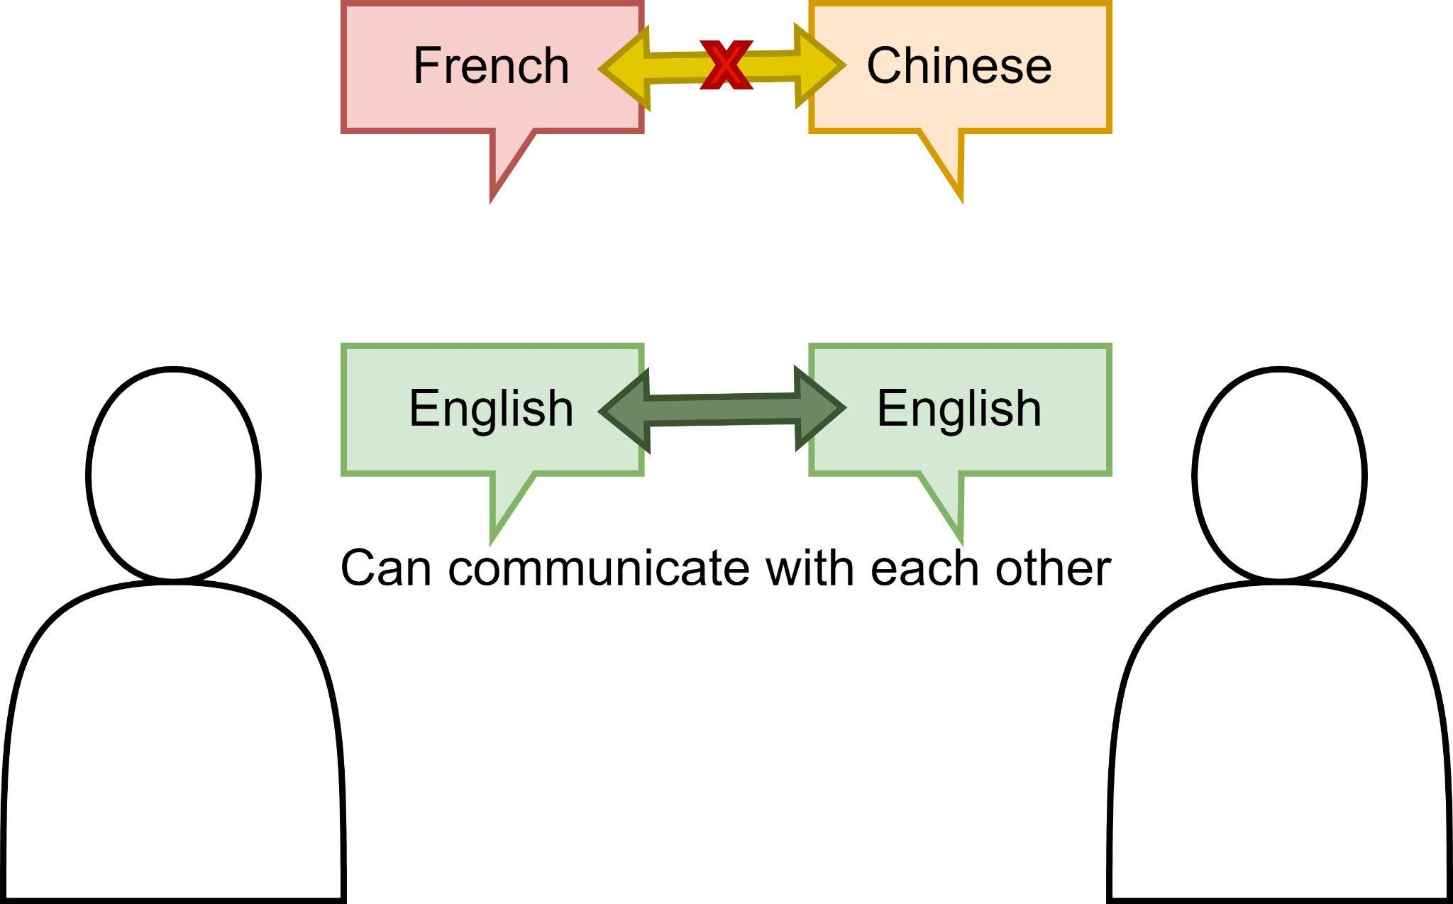
2. PROBLEM STATEMENT
RESEARCH PROBLEM
Motivation for multi-vendor strategy
Different technical requirements and features [12]
Increase flexibility
Vendor independency
Decrease costs
Problem Statement
Vendor-specific systems [6]
→ Need for communication standard
Communication standards under development [6]
Address external interfaces of mobile robots
→ Need for middleware
Lack of middleware
Fig. 3 Human analogue of a communication standard
Notes:
Slide with one picture
Remarks:
picture is to be placed preferably on the left hand side
picture should be framed and have a small shadow (use features of the presentation tool, but make sure to use the same properties on all slides)
text goes on the right hand side
normal text in bullet points: Helvetica 30 pts (or larger, but use the same font size on all slides)
titles for bullet points: Helvetica 40 pts (or larger, approx 10pts larger than normal text, but use the same font size on all slides) - titles for bullet points are optional
Slide title: Helvetica, 45 pt, bold, uppercase (mandatory)
Slide sub-title: Helvetica, 45 pt, uppercase (optional)
Reference lines are like red lines - they must not be crossed (only in some exceptional cases like for pictures with oversize)
Slide is to be built from bottom to top - start with aligning content and pictures at the bottom reference line

Slide 5
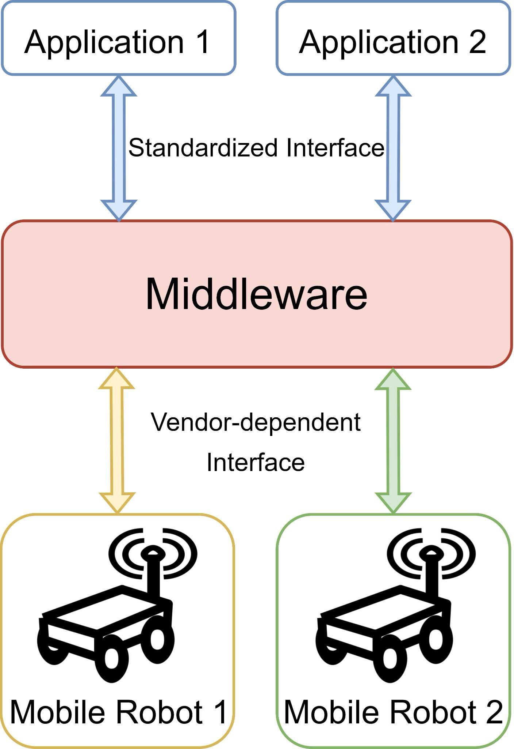
3. TASK DESCRIPTION
MIDDLEWARE FOR MULTI-VENDOR COMMUNICATION
Must be done
Two mobile robots from different vendors must be controllable via a middleware
Mobile robots must drive from point A to point B
Middleware must have a connection to an application controlling the mobile robots
Should be done
Middleware should have a connection to a business process management system
Existing communication standards should be used
Mobile robots should be assigned depending on their functional requirements or data
Middleware designed for simple integration with new robots
May be done
Mobile robots may pick up and drop off a load
Mobile robots may charge
Middleware may be designed to add further mobile robots’ actions
*
Fig. 4 Middleware for multi-vendor mobile robot communication
* Mobile robot icon from [13]
Notes:
Slide with text in two columns
Remarks:
Reference lines are like red lines - they must not be crossed (only in some exceptional cases like for pictures with oversize)
Slide is to be built from bottom to top - start with aligning content and pictures at the bottom reference line
Slide title: Helvetica, 45 pt, bold, uppercase (mandatory)
Slide sub-title: Helvetica, 45 pt, uppercase (optional)
normal text in bullet points: Helvetica 30 pts (or larger, but use the same font size on all slides)
titles for bullet points: Helvetica 40 pts (or larger, approx 10pts larger than normal text, but use the same font size on all slides) - titles for bullet points are optional

Slide 6
4. RESEARCH QUESTIONS
Main research question
How to improve communication of process automation systems with mobile robots from different vendors?
(With focus on simplifying the integration of multiple mobile robots)
Identify state-of-the-art for multi-vendor mobile robots approaches
Identify existing protocols & communication standards
Compare protocols & standards
Evaluate suitable communication protocols & standards
Identify which data needs to be communicated
Identify approach to integrate business process management system and process control application
Optional research question
How do mobile robots from different vendors communicate with each other in a production plant?
Compare direct & indirect communication
Identify challenges
Notes:
Slide with text in two columns
Remarks:
Reference lines are like red lines - they must not be crossed (only in some exceptional cases like for pictures with oversize)
Slide is to be built from bottom to top - start with aligning content and pictures at the bottom reference line
Slide title: Helvetica, 45 pt, bold, uppercase (mandatory)
Slide sub-title: Helvetica, 45 pt, uppercase (optional)
normal text in bullet points: Helvetica 30 pts (or larger, but use the same font size on all slides)
titles for bullet points: Helvetica 40 pts (or larger, approx 10pts larger than normal text, but use the same font size on all slides) - titles for bullet points are optional

Slide 7

5. RELATED WORK
MassRobotics AMR Interoperability Standard
Released in May 2021 [15]
Goal: develop standards to enable use of AMR from different vendors [15, 16]
Standardized way to share information [16]
Manufacturer name, robot model
Position
Operational state
Battery Level
Fig. 5 MassRobotics AMR interoperability standard logo [14]
Notes:
Slide with text in two columns
Remarks:
Reference lines are like red lines - they must not be crossed (only in some exceptional cases like for pictures with oversize)
Slide is to be built from bottom to top - start with aligning content and pictures at the bottom reference line
Slide title: Helvetica, 45 pt, bold, uppercase (mandatory)
Slide sub-title: Helvetica, 45 pt, uppercase (optional)
normal text in bullet points: Helvetica 30 pts (or larger, but use the same font size on all slides)
titles for bullet points: Helvetica 40 pts (or larger, approx 10pts larger than normal text, but use the same font size on all slides) - titles for bullet points are optional

Slide 8

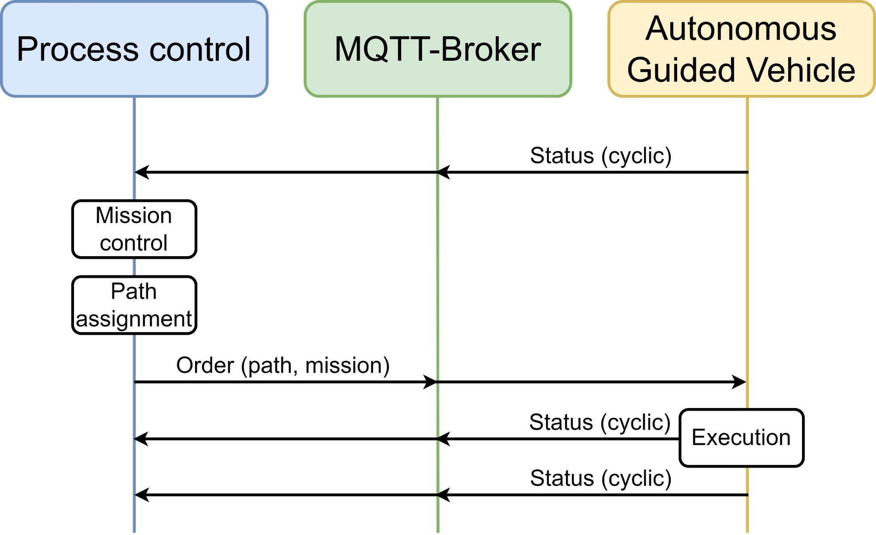
5. RELATED WORK
VDA 5050
Released in August 2019 [17]
Standardized interface for AGV communication [18]
Communication of status and mission data between AGV and master control [18]
Goal: use of multi-vendor AGVs and simple integration of new AGVs [18]
Requirements: Pull principle [18, 19]
Defines actions: [19]
Driving
Pick up & drop load
Charging, pause mode, detect object, wait for trigger
Fig. 6 VDA logo [17]
Fig. 7 Process and communication of VDA 5050, derived from [19]
Notes:
Slide with text in two columns
Remarks:
Reference lines are like red lines - they must not be crossed (only in some exceptional cases like for pictures with oversize)
Slide is to be built from bottom to top - start with aligning content and pictures at the bottom reference line
Slide title: Helvetica, 45 pt, bold, uppercase (mandatory)
Slide sub-title: Helvetica, 45 pt, uppercase (optional)
normal text in bullet points: Helvetica 30 pts (or larger, but use the same font size on all slides)
titles for bullet points: Helvetica 40 pts (or larger, approx 10pts larger than normal text, but use the same font size on all slides) - titles for bullet points are optional

Slide 9
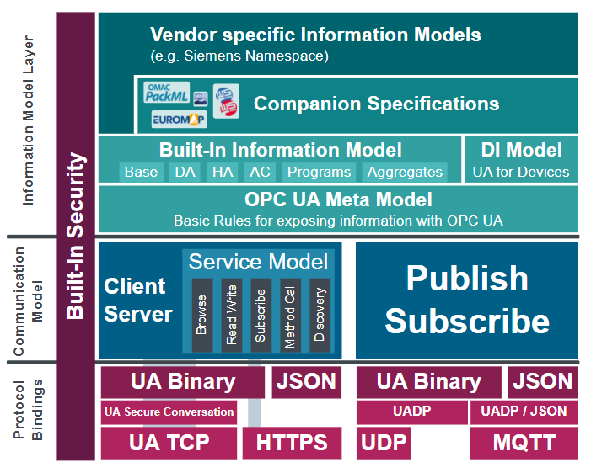

5. RELATED WORK
OPC UA
Fig. 8 OPC UA logo [20]
Platform independent service-oriented architecture [21]
Standard for data exchange from sensors to cloud applications [21]
Goal: create common language for machines [21]
OPC UA Robotics companion specification
Released in May 2019 [22]
Information for asset management and condition monitoring [22]
Motors, manipulators, controllers, software
Fig. 9 OPC UA architecture [23]
Notes:
Slide with text in two columns
Remarks:
Reference lines are like red lines - they must not be crossed (only in some exceptional cases like for pictures with oversize)
Slide is to be built from bottom to top - start with aligning content and pictures at the bottom reference line
Slide title: Helvetica, 45 pt, bold, uppercase (mandatory)
Slide sub-title: Helvetica, 45 pt, uppercase (optional)
normal text in bullet points: Helvetica 30 pts (or larger, but use the same font size on all slides)
titles for bullet points: Helvetica 40 pts (or larger, approx 10pts larger than normal text, but use the same font size on all slides) - titles for bullet points are optional

Slide 10
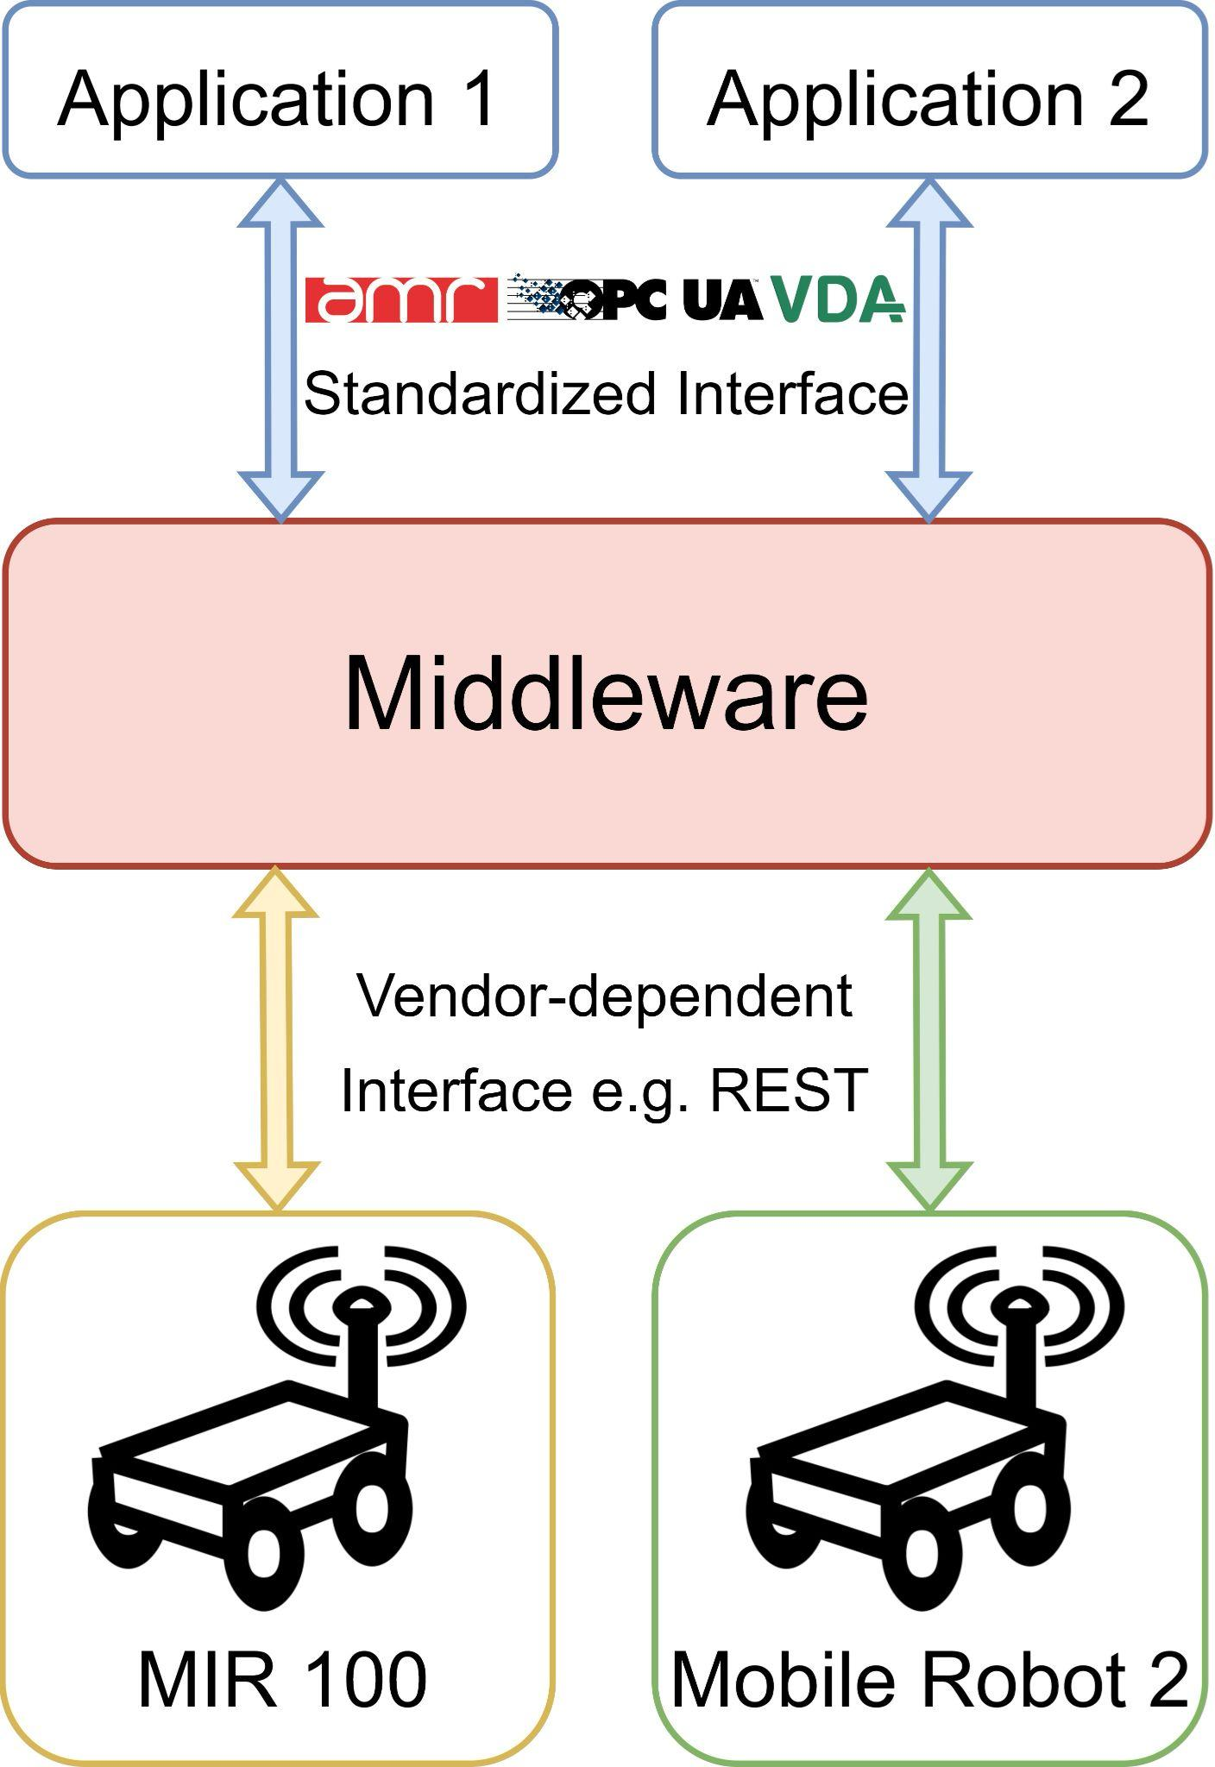
6. TASK DESCRIPTION
MIDDLEWARE FOR MULTI-VENDOR COMMUNICATION
*
Fig. 4 Middleware for multi-vendor mobile robot communication
* AMR, OPC UA and VDA logos and mobile robot icon from [13, 14, 17, 20]
Notes:
Slide with text in two columns
Remarks:
Reference lines are like red lines - they must not be crossed (only in some exceptional cases like for pictures with oversize)
Slide is to be built from bottom to top - start with aligning content and pictures at the bottom reference line
Slide title: Helvetica, 45 pt, bold, uppercase (mandatory)
Slide sub-title: Helvetica, 45 pt, uppercase (optional)
normal text in bullet points: Helvetica 30 pts (or larger, but use the same font size on all slides)
titles for bullet points: Helvetica 40 pts (or larger, approx 10pts larger than normal text, but use the same font size on all slides) - titles for bullet points are optional

Slide 11
7. SIGNIFICANCE
Multi-vendor mobile robot strategies
Proof-of-concept for existing protocols & standards
Advantages:
Simple integration for multiple mobile robots (“plug and play”)
Increased flexibility
Reduce costs
Minimize errors
Pilot project
Mobile robot is unloaded after manual user input [8]
→ Fully automating the process
Notes:
Slide with text in two columns
Remarks:
Reference lines are like red lines - they must not be crossed (only in some exceptional cases like for pictures with oversize)
Slide is to be built from bottom to top - start with aligning content and pictures at the bottom reference line
Slide title: Helvetica, 45 pt, bold, uppercase (mandatory)
Slide sub-title: Helvetica, 45 pt, uppercase (optional)
normal text in bullet points: Helvetica 30 pts (or larger, but use the same font size on all slides)
titles for bullet points: Helvetica 40 pts (or larger, approx 10pts larger than normal text, but use the same font size on all slides) - titles for bullet points are optional

Slide 12
8. REFERENCES
Industrie 4.0 - BMBF. In: Bundesministerium für Bildung und Forschung - BMBF [Internet]. [cited 25 Apr 2022]. Available: https://www.bmbf.de/bmbf/de/forschung/digitale-wirtschaft-und-gesellschaft/industrie-4-0/industrie-4-0.html
Kumar A, Gupta D. Challenges Within the Industry 4.0 Setup. A Roadmap to Industry 4.0: Smart Production, Sharp Business and Sustainable Development. 2020. pp. 187–205. doi:10.1007/978-3-030-14544-6_11
Hamner B, Koterba S, Shi J, Simmons R, Singh S. An autonomous mobile manipulator for assembly tasks. Autonomous Robots. 2010. pp. 131–149. doi:10.1007/s10514-009-9142-y
Cupek R, Drewniak M, Fojcik M, Kyrkjebø E, Lin JC-W, Mrozek D, et al. Autonomous Guided Vehicles for Smart Industries – The State-of-the-Art and Research Challenges. Lecture Notes in Computer Science. 2020. pp. 330–343. doi:10.1007/978-3-030-50426-7_25
Willibald Günthner MTH. Internet der Dinge. Springer-Verlag; 2010.
Sanneman L, Fourie C, Shah JA. The State of Industrial Robotics: Emerging Technologies, Challenges, and Key Research Directions. 2021.
Evely Naudorf AAS. On the Road to the Future. BASF Intranet. 2 Aug 2022.
Marco Burkhart TG. TE Spotlight Pilotprojekt Outdoor AGV Standort Kaisten, Schweiz. 2022 May 4; Ludwigshafen am Rhein.
Stäubli WFT. Pflichtenheft Fahreloses Transportsystem WFTPF230 Version 1.0. 2021.
Toyota Material Handling. DEMO Fahrelose Transportsysteme. 2021.
Lambrecht J, Chemnitz M, Kruger J. Control layer for multi-vendor industrial robot interaction providing integration of supervisory process control and multifunctional control units. 2011 IEEE Conference on Technologies for Practical Robot Applications. 2011. doi:10.1109/tepra.2011.5753492
Beasley G. Autonomous Mobile Robots Icon, HD Png Download - kindpng. In: KindPNG.com [Internet]. [cited 1 May 2022]. Available: https://www.kindpng.com/imgv/iixwbwo_autonomous-mobile-robots-icon-hd-png-download/
[No title]. [cited 1 May 2022]. Available: https://storage.googleapis.com/accesswire/media/647765/AMRinteropMR-logo.jpg
Notes:
Slide with text in two columns
Remarks:
Reference lines are like red lines - they must not be crossed (only in some exceptional cases like for pictures with oversize)
Slide is to be built from bottom to top - start with aligning content and pictures at the bottom reference line
Slide title: Helvetica, 45 pt, bold, uppercase (mandatory)
Slide sub-title: Helvetica, 45 pt, uppercase (optional)
normal text in bullet points: Helvetica 30 pts (or larger, but use the same font size on all slides)
titles for bullet points: Helvetica 40 pts (or larger, approx 10pts larger than normal text, but use the same font size on all slides) - titles for bullet points are optional

Slide 13
8. REFERENCES
MassRobotics Publishes World’s First Open Source Autonomous Mobile Robot Interoperability Standards. [cited 1 May 2022]. Available: https://www.accesswire.com/647765/MassRobotics-Publishes-Worlds-First-Open-Source-Autonomous-Mobile-Robot-Interoperability-Standards
MassRobotics-AMR. AMR_Interop_Standard/AMR_Interop_Standard.pdf at main · MassRobotics-AMR/AMR_Interop_Standard. In: GitHub [Internet]. [cited 1 May 2022]. Available: https://github.com/MassRobotics-AMR/AMR_Interop_Standard
VDA 5050: Dirigent der Werkhallen. [cited 1 May 2022]. Available: https://www.vda.de/de/aktuelles/Artikel/vda-5050
Redaktion F. VDA 5050. In: FLEXUS Premium SAP Intralogistics [Internet]. 7 Dec 2021 [cited 1 May 2022]. Available: https://www.flexus.de/glossar/vda-5050/
VDA. Schnittstelle zur Kommunikation zwischen Fahrerlosen Transportfahrzeugen (FTF) und einer Leitsteuerung VDA 5050. VDA VDMA; 2022 Jan.
FDT-Group. In: OPC Foundation [Internet]. 2 Mar 2017 [cited 1 May 2022]. Available: https://opcfoundation.org/markets-collaboration/fdt/
OPC UA Demonstrator by VDMA Robotics + Automation. In: TODO [Internet]. [cited 1 May 2022]. Available: https://automatica-munich.com/en/supporting-program/demoparks/opc-ua-demonstrator/
OPC UA Information Models. In: OPC Foundation [Internet]. 15 Jul 2013 [cited 1 May 2022]. Available: https://opcfoundation.org/products/view/opc-factory-server/
01_de_OpcUaSpecificationOverview. [cited 1 May 2022]. Available: https://cache.industry.siemens.com/dl/dl-media/906/109776906/att_1012619/v1/109776906_OPCUA_1_Basics_WBT_DE/start.html?lang=de
Notes:
Slide with text in two columns
Remarks:
Reference lines are like red lines - they must not be crossed (only in some exceptional cases like for pictures with oversize)
Slide is to be built from bottom to top - start with aligning content and pictures at the bottom reference line
Slide title: Helvetica, 45 pt, bold, uppercase (mandatory)
Slide sub-title: Helvetica, 45 pt, uppercase (optional)
normal text in bullet points: Helvetica 30 pts (or larger, but use the same font size on all slides)
titles for bullet points: Helvetica 40 pts (or larger, approx 10pts larger than normal text, but use the same font size on all slides) - titles for bullet points are optional

Slide 14




TU Berlin | Telekom Innovation Laboratories | Fachgebiet Service-centric Networking
Ernst-Reuter-Platz 7 | 10587 Berlin | Germany
axel.kuepper@tu-berlin.de
https://twitter.com/kuepp
https://www.linkedin.com/in/axelkuepper/
http://www.snet.tu-berlin.de/kuepper
Mai Khanh Isabelle Wilhelm
TU Berlin | Telekom Innovation Laboratories | Fachgebiet Service-centric Networking
Ernst-Reuter-Platz 7 | 10587 Berlin | Germany
iwilhelm@kth.se
Notes:
Last slide of the presentation (mandatory for all slide)
Remarks:
Reference lines are like red lines - they must not be crossed (only in some exceptional cases like for pictures with oversize)
Slide is to be built from bottom to top - start with aligning content and pictures at the bottom reference line
font sizes and logos as shown
keep logos, footer and page number in the foreground
Choose appropriate color for headline and normal text fonts

